Slide 1
Transportation and Mobility Needfinding
Asa Kohrman, Marco Pizarro, Max Vandervelden

Slide 2



Who are we?
Max
Asa
Marco

Slide 3
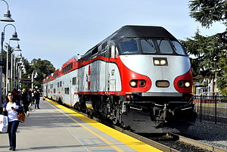
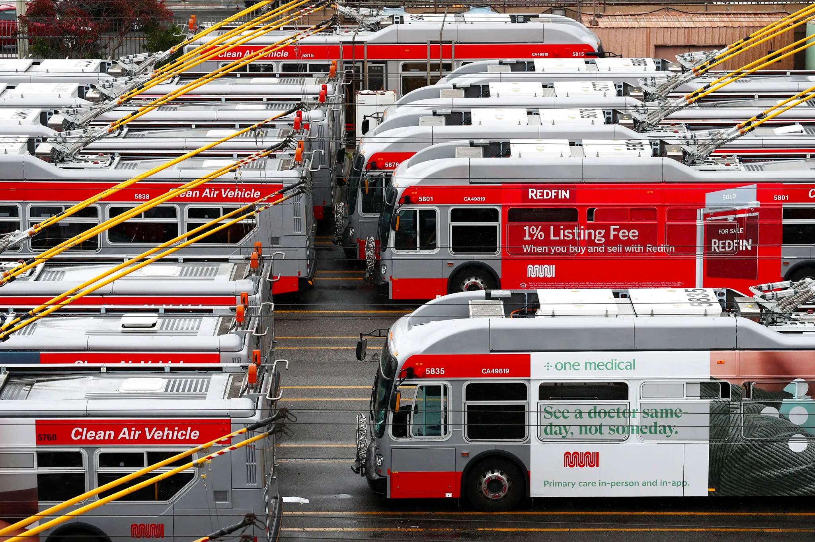
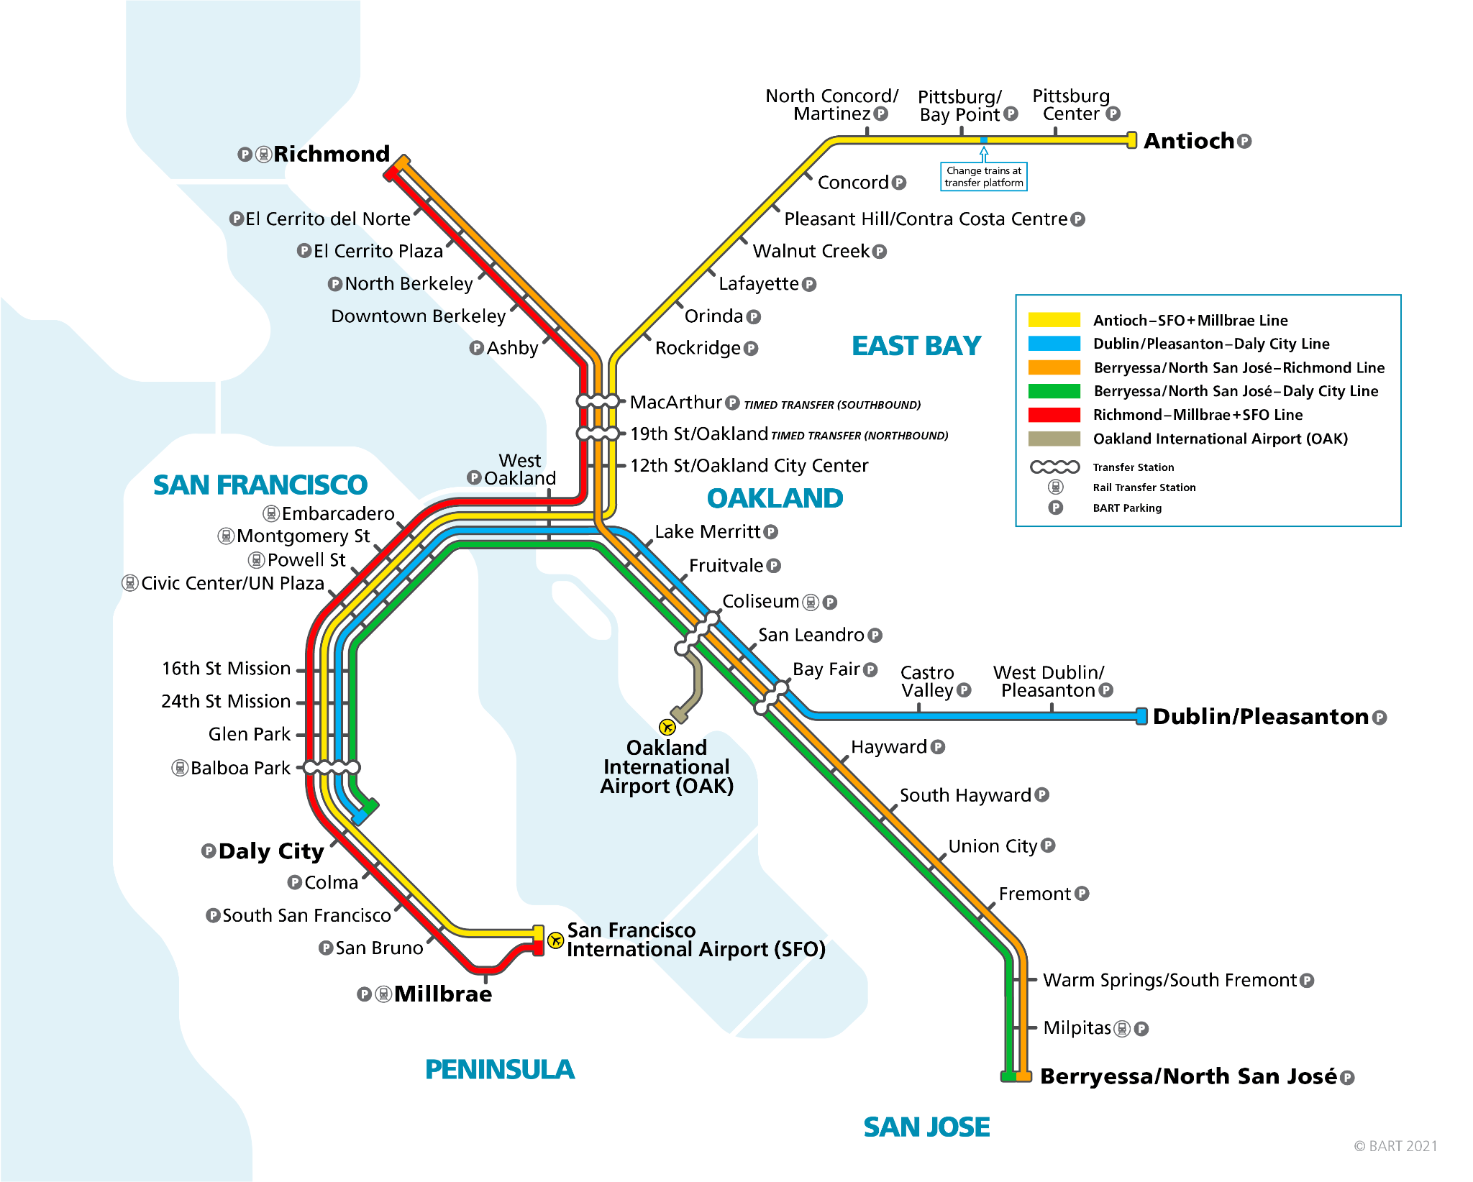
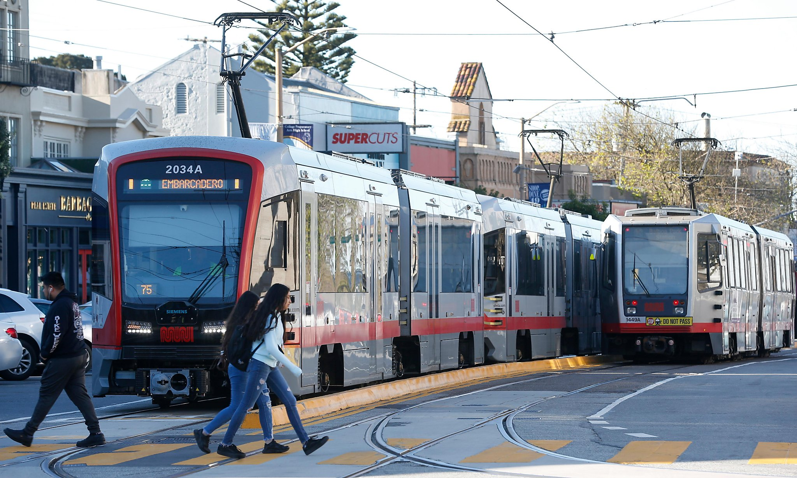
Our Problem Domain: Public Transit

Slide 4
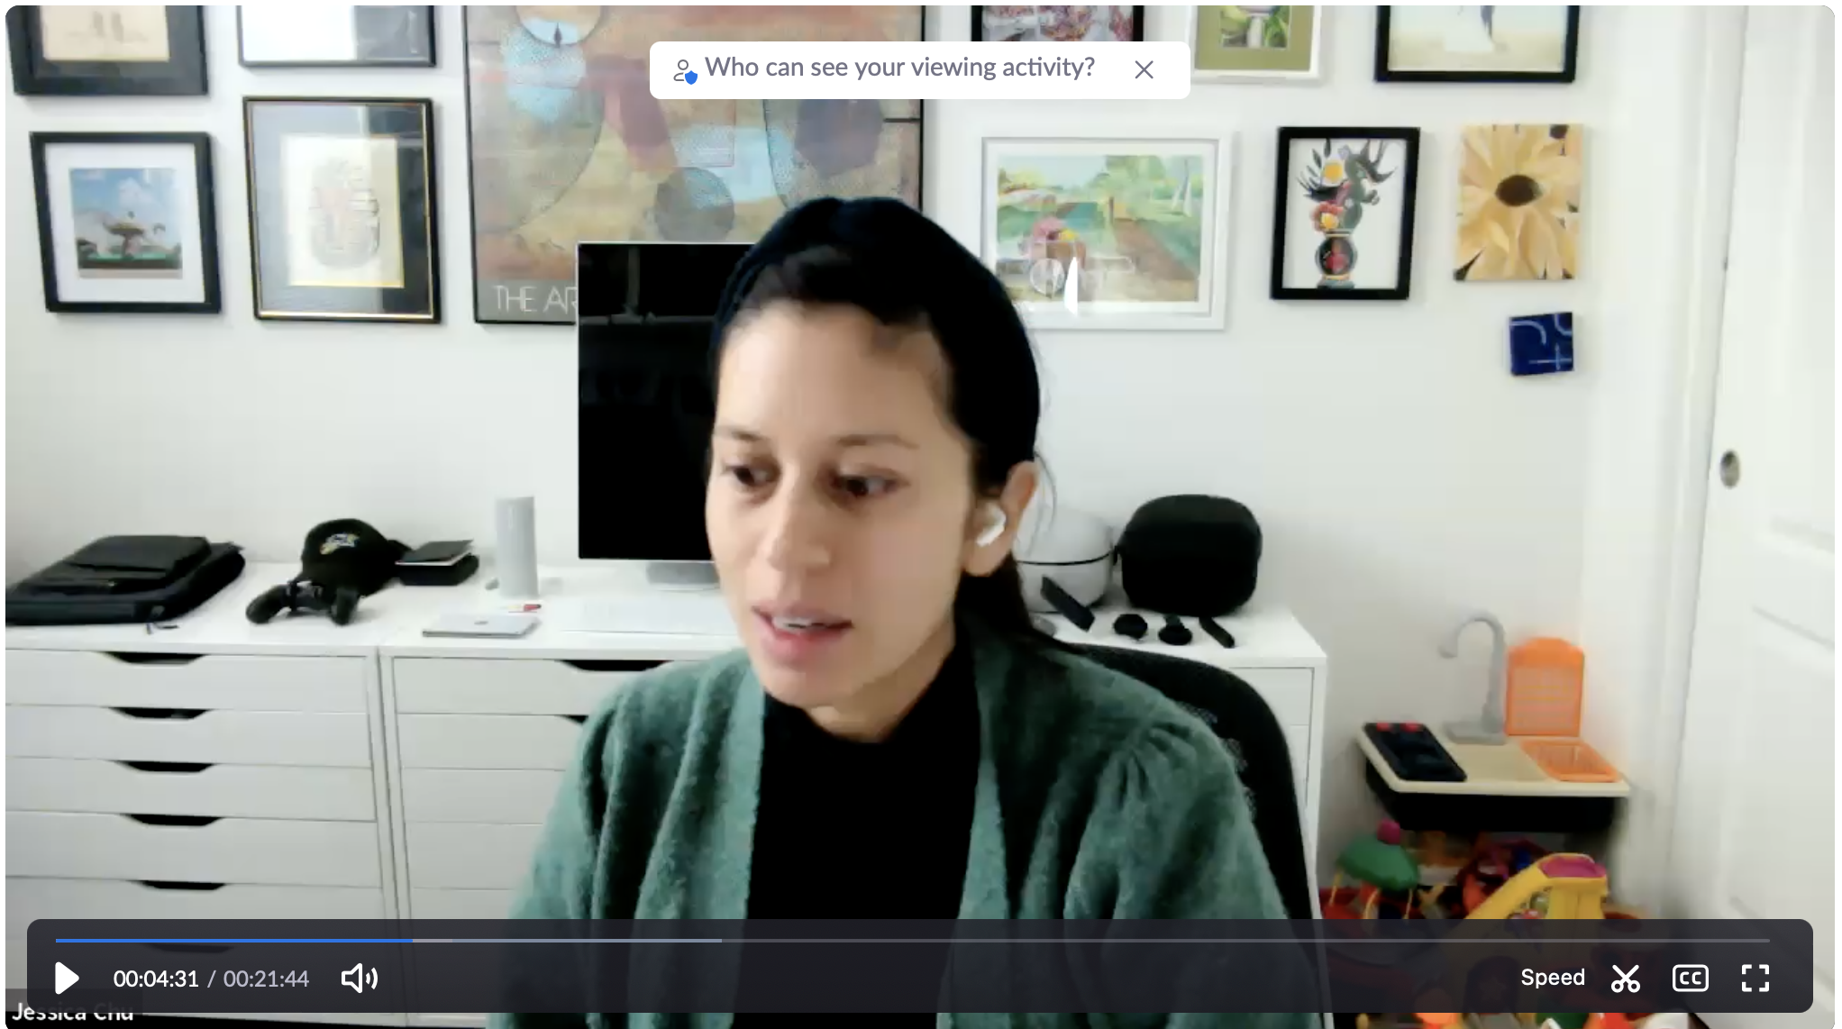
Methodology
Interviewed people over Zoom and on the CalTrain during rush hour commuting times (4 PM - 6PM)
On Zoom - coordinated ahead of time
On Caltrain - approached while on the train, few minutes taken in each interview to introduce and build rapport
Focused on individuals who used multiple forms of transport, i.e. train, bus, corporate shuttle, and scooter

Slide 5
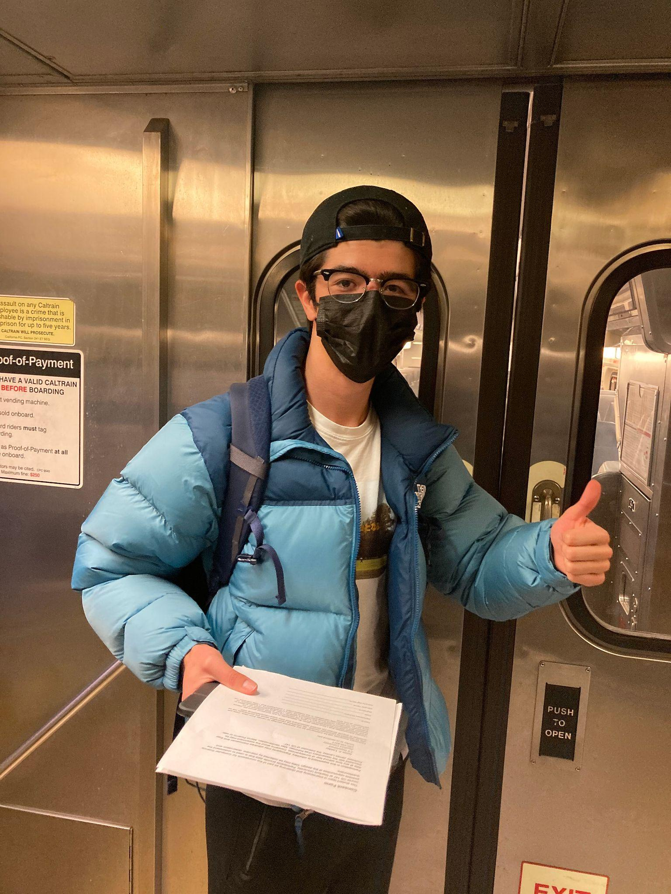
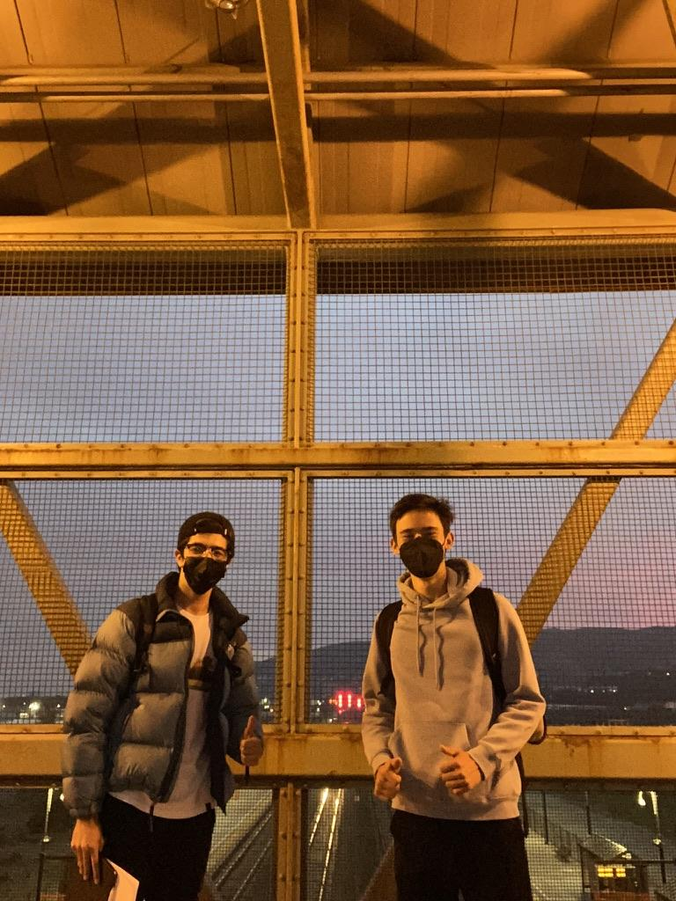
Methodology (cont’d)
Extreme Users
While on the train, we found people who only take public transit to get around
Average Users
People who infrequently used the train, those who paid entirely for their trips
Non-Users
People who rarely take public transportation, prefer other means

Slide 6
Questions
What makes public transportation viable for you?
How do you travel from place to place?
Tell me about a positive/negative experience with public transit.
Tell me about a time when you explored a new area using public transportation.
How do you coordinate transfers?
What’s the economic impact?
How does the social aspect factor into your experience?

Slide 7
Interviews:
Grace, Christine, Marina, Caroline, Elsa, Jessi

Slide 8

“It’s a pain to use buses.”
“I spontaneously went to the end of the CalTrain southbound line to get a tattoo.”
“California isn’t built for public transit”
Grace
Late-20s Stanford employee
interviewed on the CalTrain
Average User

Slide 9

“Because of the pandemic, I only commute maybe 5 days in a month.”
“I don’t use public transit in new places … I’ll get a rental car.”
Christine
Mid-20s Stanford healthcare worker interviewed on the CalTrain
Infrequent/Non-User

Slide 10

“I don’t know how to drive”
“I take public transit everywhere”
[during commute]
“I like the time to myself”
[interaction on the train]
“He offered me money to sleep with him”
Marina
Early-20s commuter without a license interviewed on the CalTrain
Extreme User

Slide 11

"I commute by train partly for environmental reasons, partly for cost."
“It takes an unreasonable amount of time.”
[about commute]
“It's a little buffer between work and home”
[about European systems]
"you could get on easy, rapid, safe public transit."
Caroline
Middle-aged commuter interviewed on the CalTrain
Average User

Slide 12

“Public transportation is safer because there are more witnesses.”
“I like seeing strangers in my day-to-day life, life is limited when you are confined to people you know. People watching adds small elements of joy.”
“Would I as an intern really be able to email the Apple CEO and ask for non-employees to take this transportation option? No. But also this is the definition of complicity.”
Elsa
Stanford Senior and tech worker who uses corporate shuttle and CalTrain
Infrequent User

Slide 13

[referring Japan/Taiwan transit systems]
“It was eye opening.”
“I just wanted to be home”
Driving home is as long (if not longer) as using CalTrain.
Jessi
Mid-30s Stanford employee who uses CalTrain and the Marguerite
Average User

Slide 14
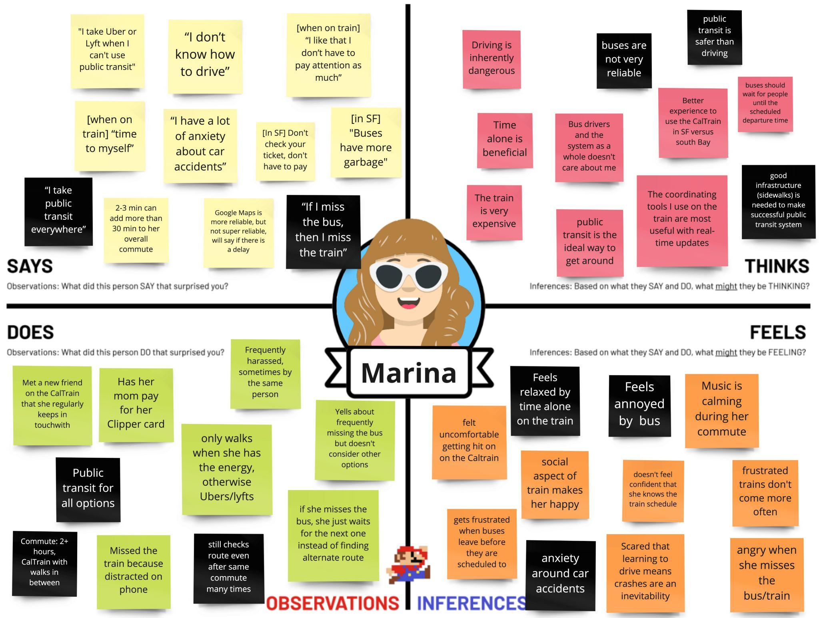

Slide 15
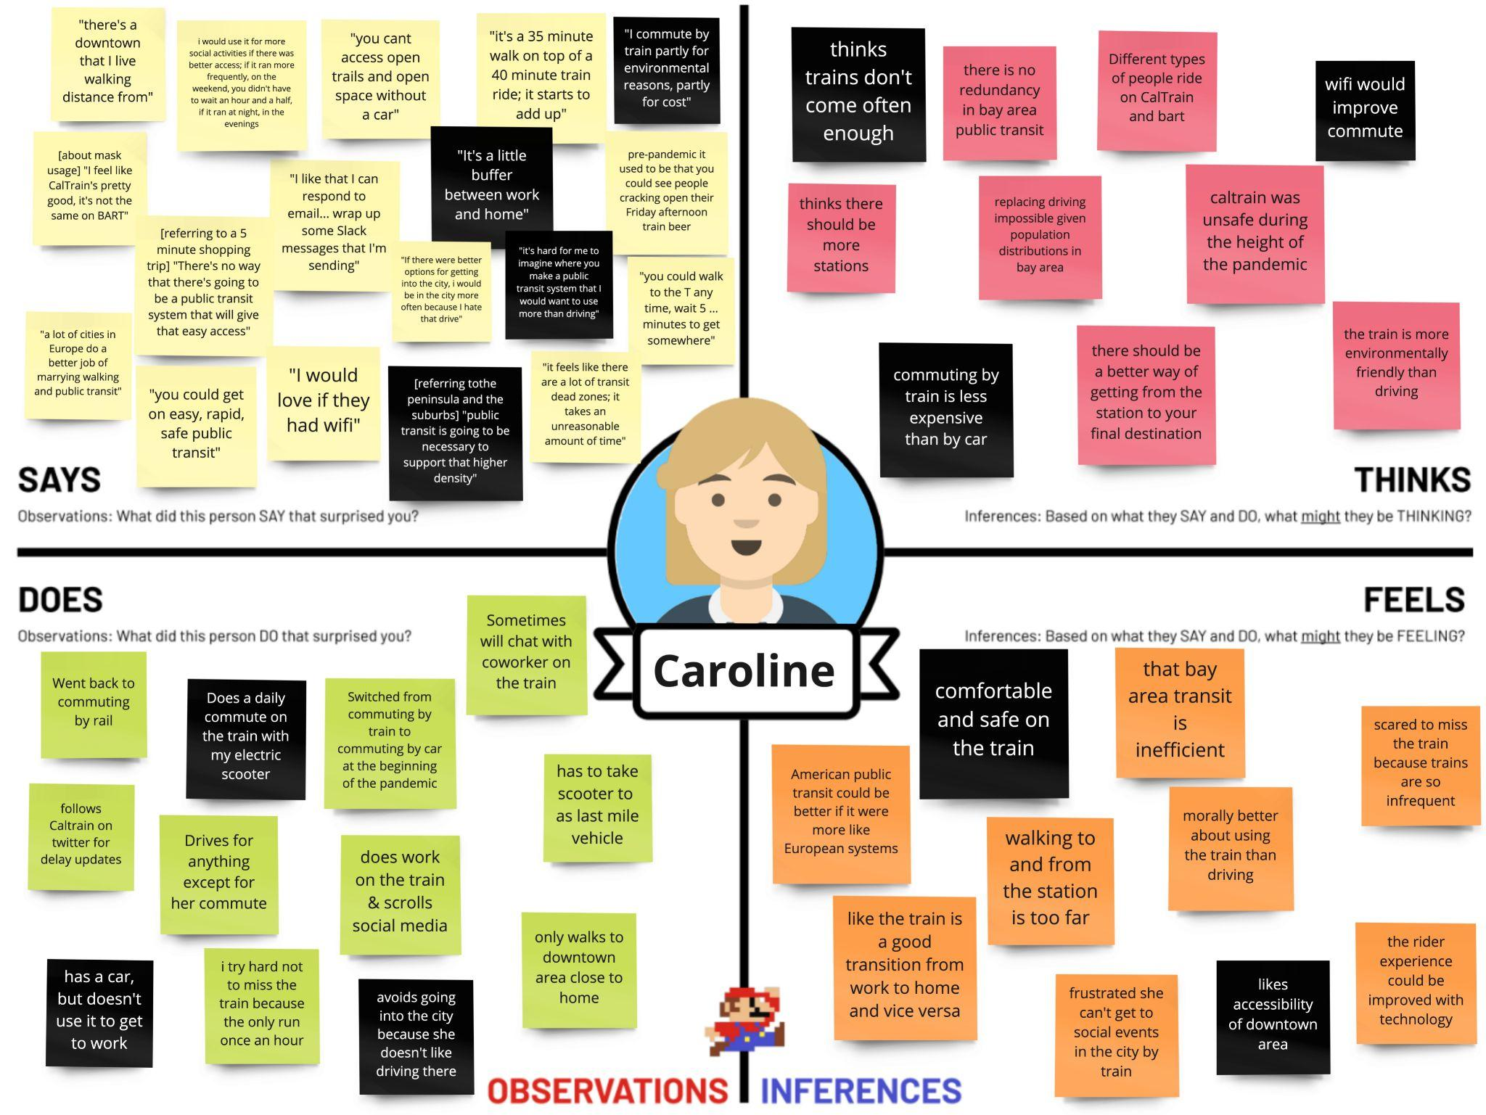

Slide 16
Tensions, Contradictions, and Surprises
Many regular public transportation users also have cars
Many public transportation users can only afford it because it is subsidized by their workplace
Transportation is both a place of fear and joy for women
People talked about sexual harassment on the train very casually
Sexual harrassment/assault is expected
Some consider driving inherently unsafe - accidents an inevitability
Notes:
Rozy “I thought I was being followed but I wasn’t actually being followed.”
Rozy “I know a lot of people who have been kidnapped by an uber but I never have.”

Slide 17
Sexual harassment common
Bus/trains often early/late
Switching between trains and buses is complicated and stressful
Google doesn’t label the way things look in the station
Google maps doesn’t cover train closures/construction
Buses are more confusing than a set subway system
Not worth the hassle
Notes:
transfers!

Slide 18
Next Steps
Greater diversity (race, gender, age, income, geographic) in future interviewees
Especially interviewing more non-users (car)
Generating interesting POVs and “How Might We” statements from interviewee experiences
Expand initial insights

